Slide 1
Project Management Critical Path Method

Slide 26
Example 2
Develop the network for a project with following activities and immediate predecessors:
Activity Immediate
predecessors
A -
B -
C B
D A, C
E C
F C
G D,E,F
Try to do for the first five (A,B,C,D,E) activities

Slide 27
Network of first five activities
A
D
1
3
4
E
B
C
5
2
We need to introduce a dummy activity

Slide 28
Network of Seven Activities
1
A
3
D
4
G
7
dummy
E
B
C
5
F
2
6
Note how the network correctly identifies D, E, and F as the immediate predecessors for activity G.
Dummy activities is used to identify precedence relationships correctly and to eliminate possible confusion of two or more activities having the same starting and ending nodes
Dummy activities have no resources (time, labor, machinery, etc) – purpose is to PRESERVE LOGIC of the network

Slide 29
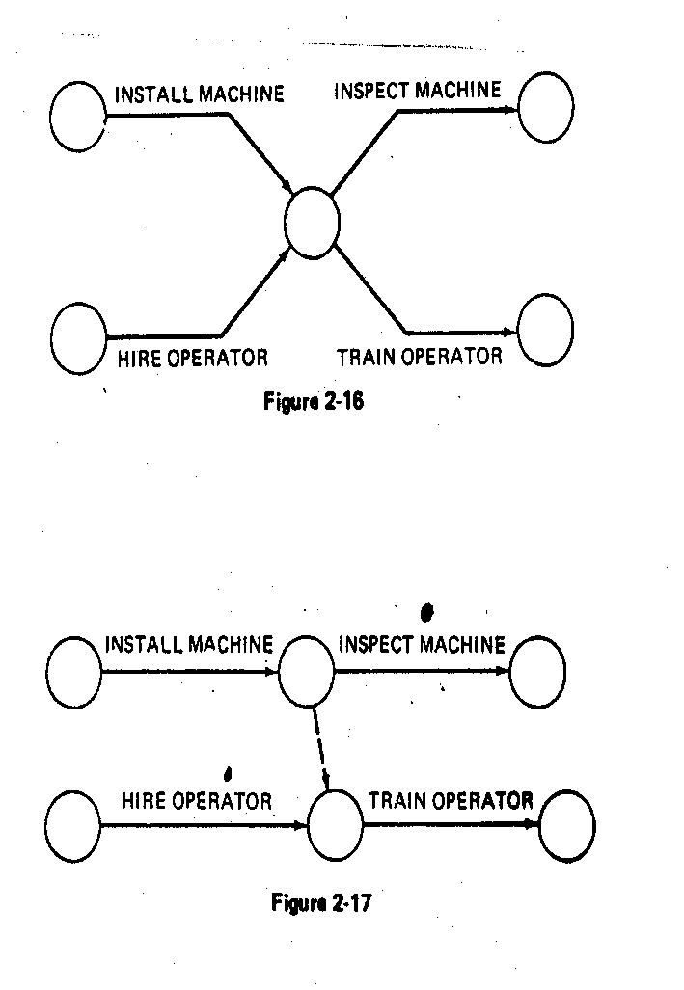
EXAMPLES OF THE USE OF DUMMYACTIVITY
Network concurrent activities
a
a
2
1
2
1
Dummy
b
b
3
WRONG!!!
RIGHT ✓
Activity c not required for e
WRONG !
a
a
d
e
1
b
1
e
b
c
d
2
c
WRONG!!!
RIGHT ✓
RIGHT ✓

Slide 30
WRONG!!!
RIGHT!!!
a
d
a
d
1
1
b
e
b
2
2
4
e
c
f
c
3
f
3
a precedes d.
a and b precede e,
b and c precede f (a does not precede f)

Slide 31
Scheduling with activity time
Activity Immediate Completion
predecessors Time (week)
A - 5
B - 6
C A 4
D A 3
E A 1
F E 4
G D,F 14
H B,C 12
I G,H 2
Total …… 51
This information indicates that the total time required to complete activities is 51 weeks. However, we can see from the network that several of the activities can be conducted simultaneously (A and B, for example).

Slide 32
Arc with ES & EF time
EF = earliest finish time
ES = earliest start time
Activity
2
A [0,5]
5
1
t = expected activity
time

Slide 33
Network with ES & EF time
D[5,8]
3
5
2
F[6,10]
4
G[10,24]
14
A[0,5]
5
E[5,6]
1
7
C[5,9]
4
4
I[24,26]
2
1
6
B[0,6]
6
H[9,21]
12
3
Earliest start time rule:
The earliest start time for an activity leaving a particular node is equal to the largest of the earliest finish times for all activities entering the node.

Slide 34
Activity, duration, ES, EF, LS, LF
EF = earliest finish time
ES = earliest start time
Activity
3
C [5,9]
4 [8,12]
2
LF = latest finish time
LS = latest start time

Slide 35
Network with LS & LF time
D[5,8]
3[7,10]
5
2
G[10,24] 14[10,24]
F[6,10]
4[6,10]
A[0,5]
5[0,5]
E[5,6]
1[5,6]
7
4
I[24,26]
2[24,26]
C[5,9]
4[8,12]
1
6
B[0,6]
6[6,12]
H[9,21]
12[12,24]
3
Latest finish time rule:
The latest finish time for an activity entering a particular node is equal to the smallest of the latest start times for all activities leaving the node.

